Slide 1
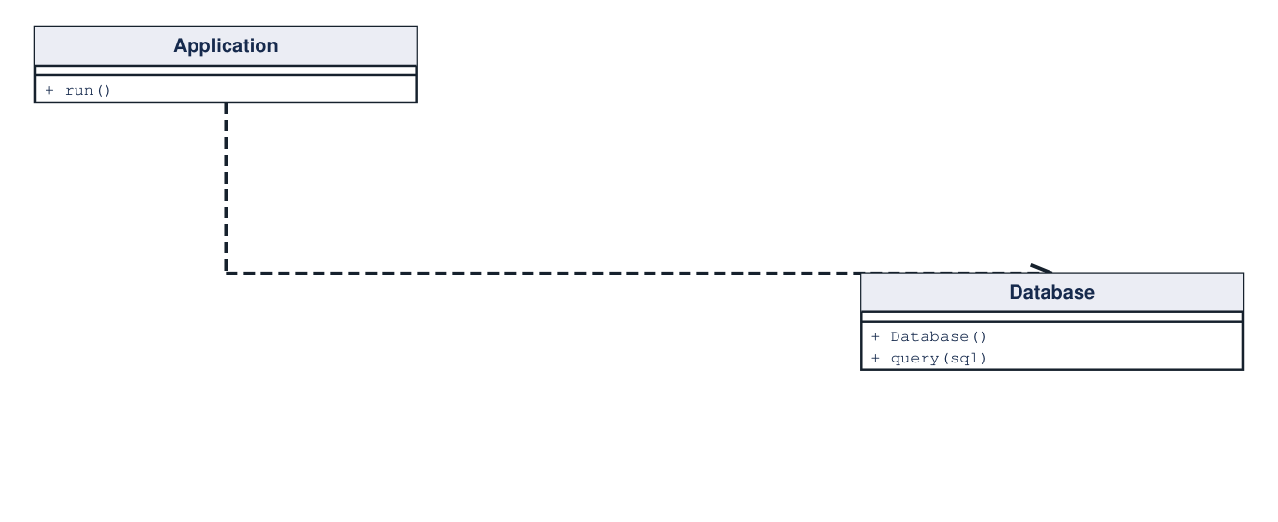
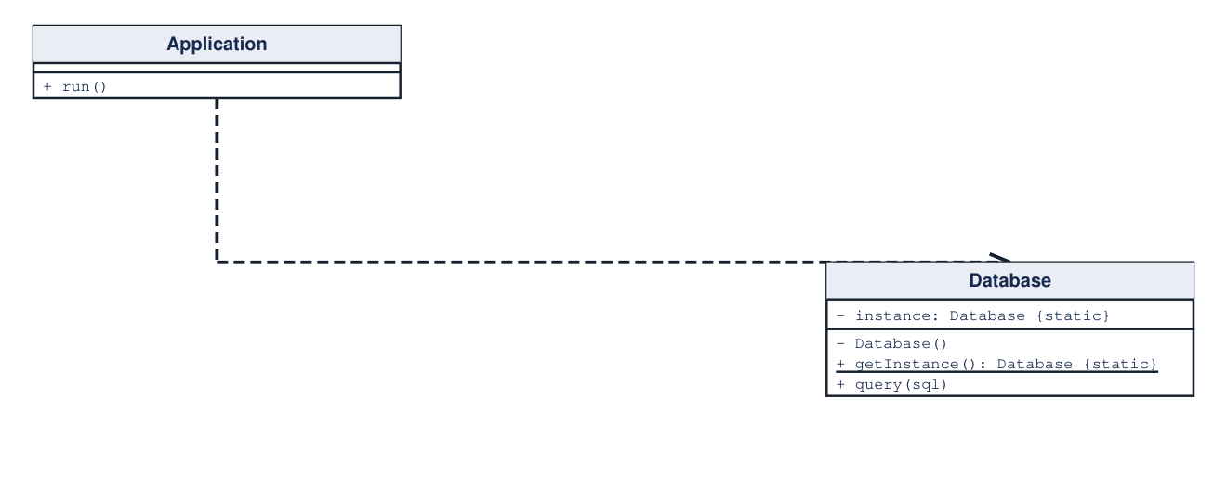
Singleton
Creational Design Pattern
Provide one shared instance through a controlled access point.
CASE STUDY: Shared database connection
01 / 14
Problem
Solution
Independent callers create separate database connections.
Hide construction; return the same instance to every caller.
Before (direct coupling)
After (using Singleton)
Client Code (Before)
Pseudocode
Client Code (After)
Pseudocode
a = new Database()
b = new Database()
a.query(sql)
// a and b are different objects
a = Database.getInstance()
b = Database.getInstance()
a.query(sql)
assert a is b
Key Implementation / Notable Module
Pseudocode
// Database: lazy, thread-safe accessor
static synchronized getInstance():
if instance == null: instance = new Database()
return instance
Source: https://refactoring.guru/design-patterns/singleton
UML: hollow triangle = inheritance / realization; dashed open arrow = dependency

Slide 2
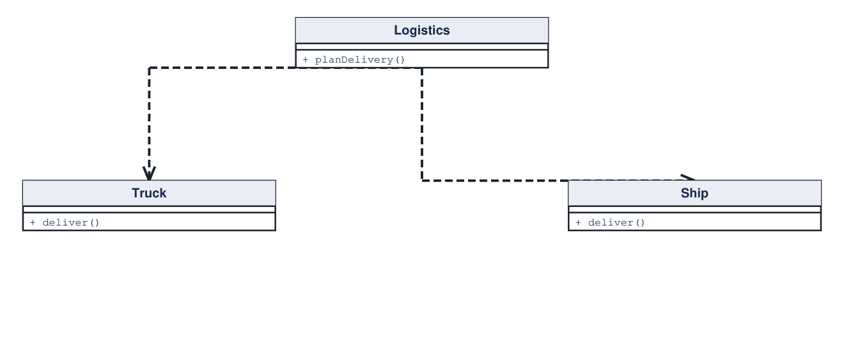
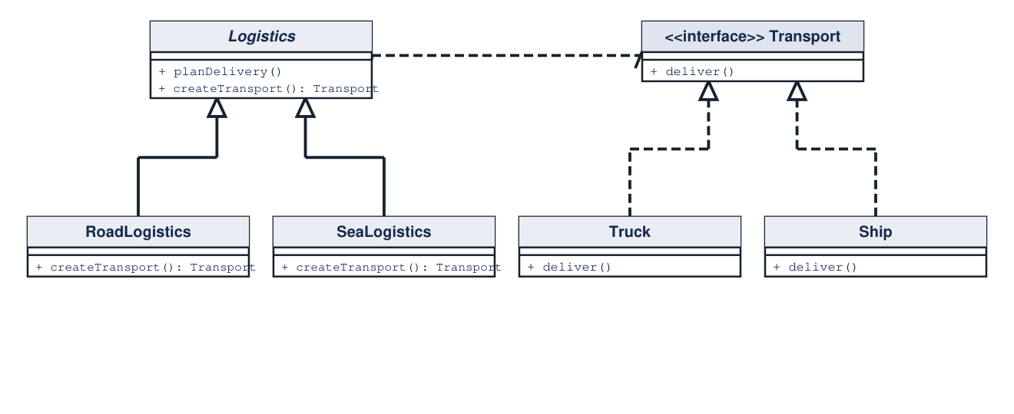
Factory Method
Creational Design Pattern
Let creator subclasses choose the product used by shared business logic.
CASE STUDY: Road and sea logistics
02 / 14
Problem
Solution
Logistics constructs concrete transports; each new kind forces edits.
Override a creation method while preserving delivery planning.
Before (direct coupling)
After (using Factory Method)
Client Code (Before)
Pseudocode
Client Code (After)
Pseudocode
truck = new Truck()
ship = new Ship()
truck.deliver()
// every new kind edits Logistics
logistics = new SeaLogistics()
logistics.planDelivery()
// planning uses Transport
Key Implementation / Notable Module
Pseudocode
// Logistics.planDelivery()
vehicle = createTransport()
vehicle.deliver()
// SeaLogistics.createTransport(): return new Ship()
Source: https://refactoring.guru/design-patterns/factory-method
UML: hollow triangle = inheritance / realization; dashed open arrow = dependency

Slide 3
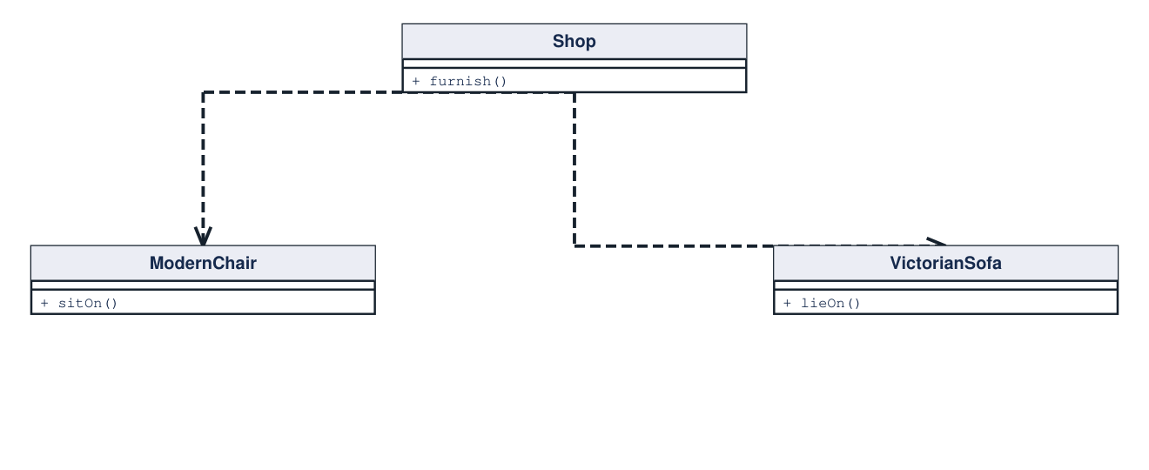
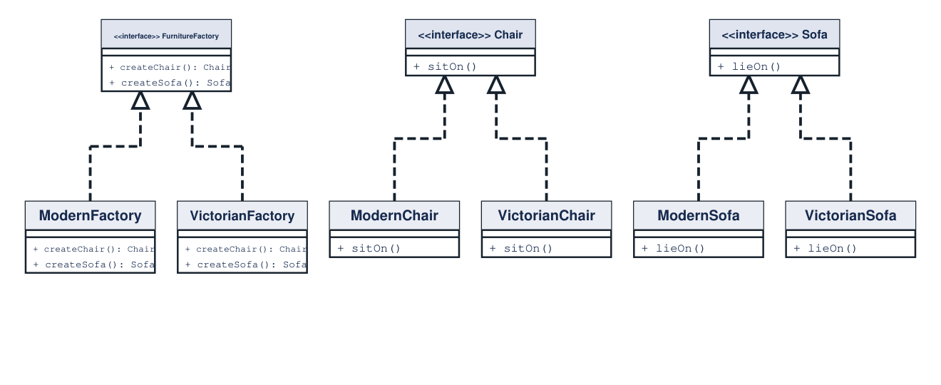
Abstract Factory
Creational Design Pattern
Create related products through a family-specific factory.
CASE STUDY: Matching furniture families
03 / 14
Problem
Solution
Direct construction can mix modern chairs with Victorian sofas.
Select one family factory; request products through interfaces.
Before (direct coupling)
After (using Abstract Factory)
Client Code (Before)
Pseudocode
Client Code (After)
Pseudocode
chair = new ModernChair()
sofa = new VictorianSofa()
// mismatched furniture family
factory = new ModernFactory()
chair = factory.createChair()
sofa = factory.createSofa()
Key Implementation / Notable Module
Pseudocode
// ModernFactory
createChair(): return new ModernChair()
createSofa(): return new ModernSofa()
// VictorianFactory returns Victorian products
Source: https://refactoring.guru/design-patterns/abstract-factory
UML: hollow triangle = inheritance / realization; dashed open arrow = dependency

Slide 4
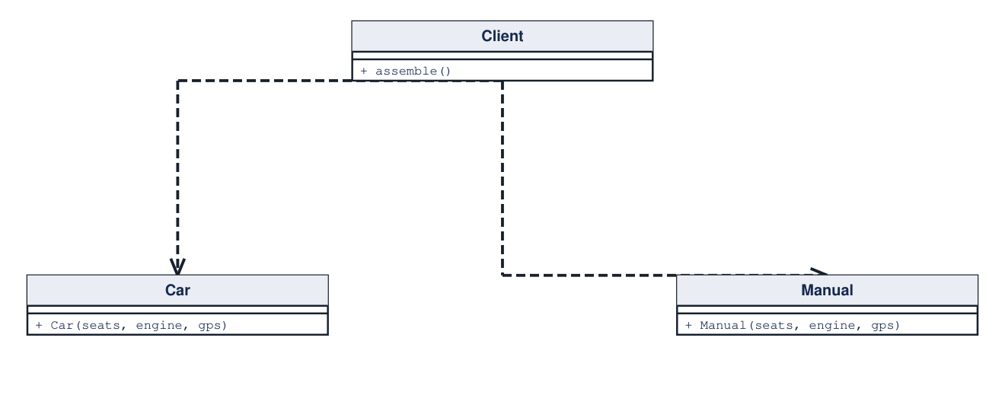
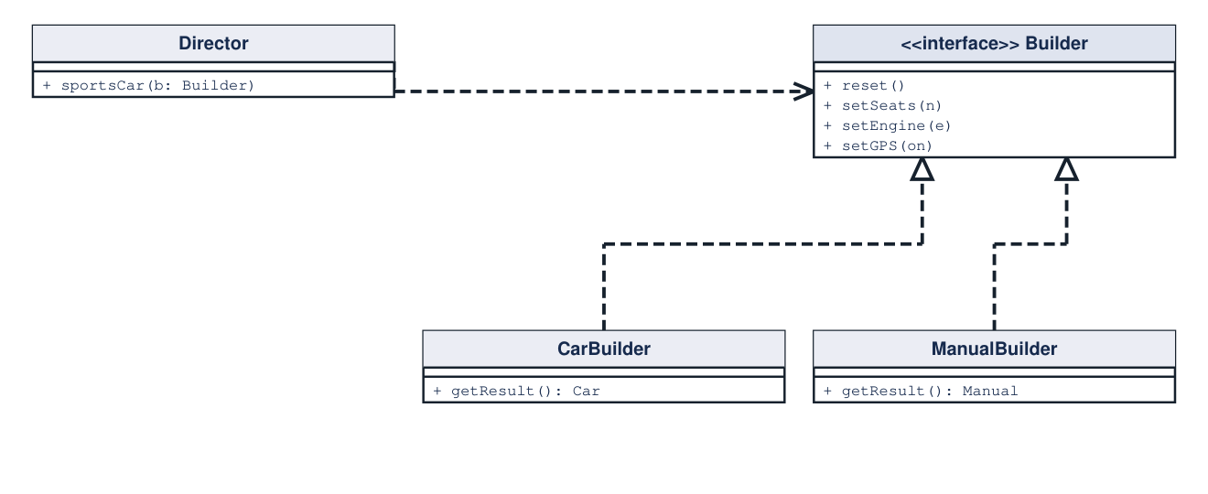
Builder
Creational Design Pattern
Separate construction steps from the representation being assembled.
CASE STUDY: Cars and their manuals
04 / 14
Problem
Solution
Long car constructors and separate manual assembly duplicate choices.
A director runs the same recipe against different builders.
Before (direct coupling)
After (using Builder)
Client Code (Before)
Pseudocode
Client Code (After)
Pseudocode
car = new Car(2, sportEngine, true)
manual = new Manual(2, "sport", "GPS")
// maintain the same recipe twice
builder = new CarBuilder()
director.sportsCar(builder)
car = builder.getResult()
// use ManualBuilder for a matching manual
Key Implementation / Notable Module
Pseudocode
// Director.sportsCar(builder)
builder.reset()
builder.setSeats(2)
builder.setEngine(sportEngine)
builder.setGPS(true)
Source: https://refactoring.guru/design-patterns/builder
UML: hollow triangle = inheritance / realization; dashed open arrow = dependency

Slide 5
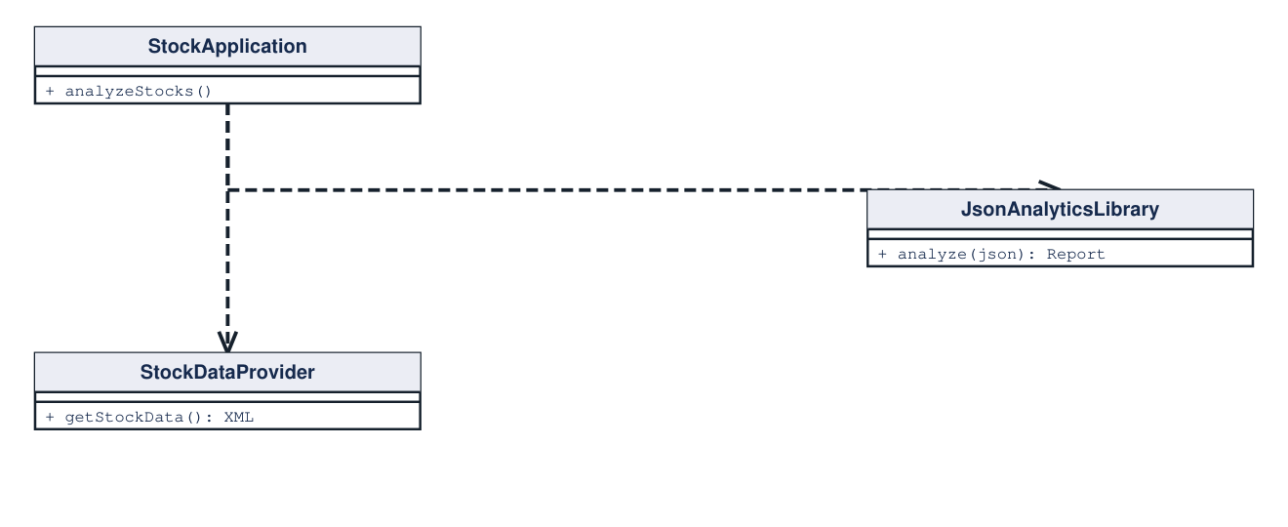
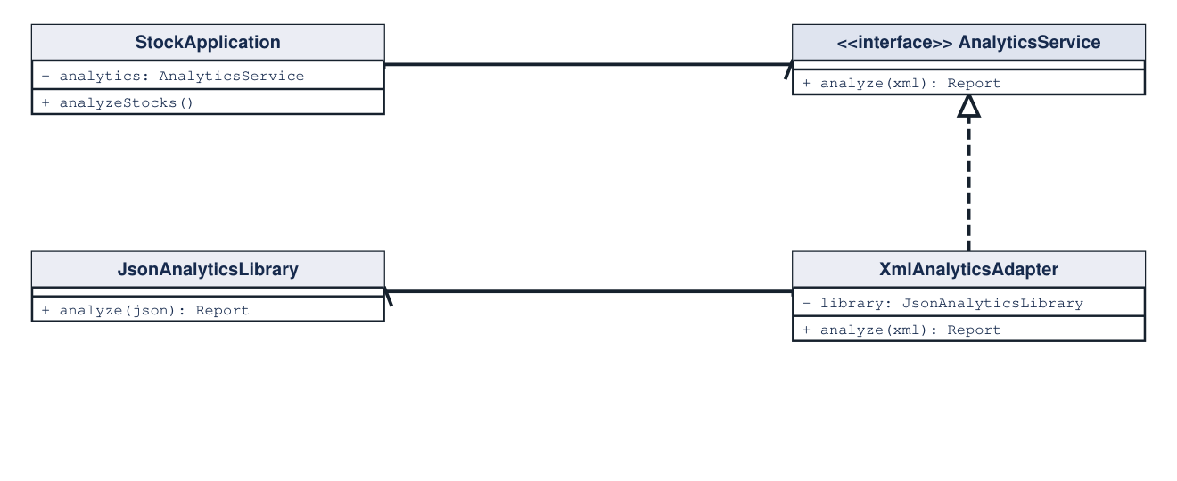
Adapter
Structural Design Pattern
Translate an existing interface into the interface a client expects.
CASE STUDY: XML stock data and JSON analytics
05 / 14
Problem
Solution
The stock app supplies XML; the analytics library requires JSON.
An adapter accepts XML, converts it, then delegates analytics.
Before (direct coupling)
After (using Adapter)
Client Code (Before)
Pseudocode
Client Code (After)
Pseudocode
xml = provider.getStockData()
library = new JsonAnalyticsLibrary()
report = library.analyze(xml)
// incompatible input format
service = new XmlAnalyticsAdapter(library)
xml = provider.getStockData()
report = service.analyze(xml)
Key Implementation / Notable Module
Pseudocode
// XmlAnalyticsAdapter.analyze(xml)
json = convertXmlToJson(xml)
return library.analyze(json)
Source: https://refactoring.guru/design-patterns/adapter
UML: hollow triangle = inheritance / realization; dashed open arrow = dependency

Slide 6
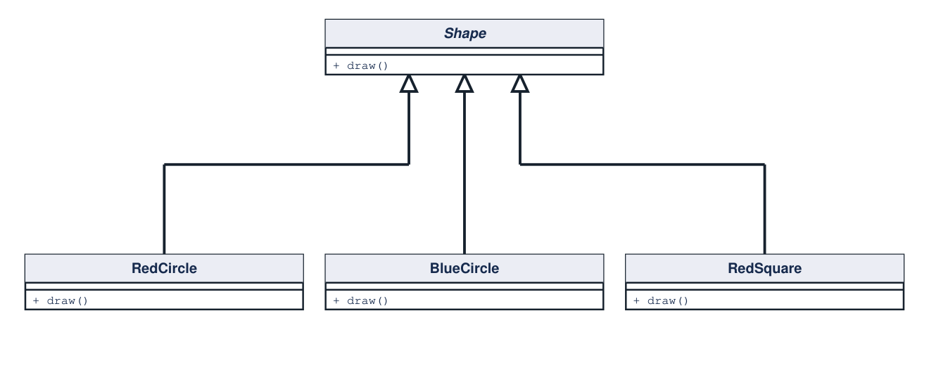
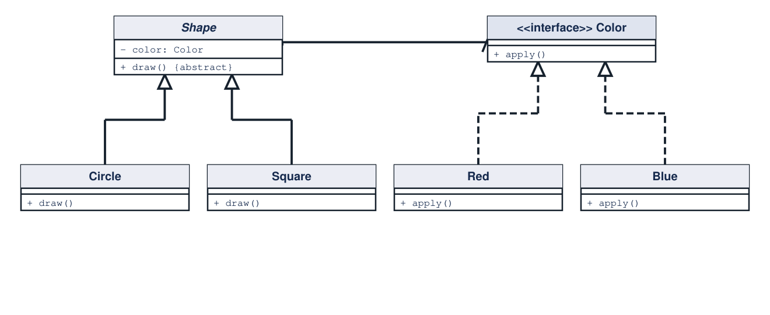
Bridge
Structural Design Pattern
Separate two independent dimensions so both can evolve independently.
CASE STUDY: Shapes and colors
06 / 14
Problem
Solution
Each shape/color combination requires another subclass.
Shapes hold a Color reference instead of encoding color in inheritance.
Before (direct coupling)
After (using Bridge)
Client Code (Before)
Pseudocode
Client Code (After)
Pseudocode
redCircle = new RedCircle()
blueSquare = new BlueSquare()
redCircle.draw()
// more combinations, more classes
shape = new Circle(new Red())
shape.draw()
shape.color = new Blue()
shape.draw()
Key Implementation / Notable Module
Pseudocode
// Circle.draw()
color.apply()
renderCircleGeometry()
// color and geometry vary independently
Source: https://refactoring.guru/design-patterns/bridge
UML: hollow triangle = inheritance / realization; dashed open arrow = dependency

Slide 7
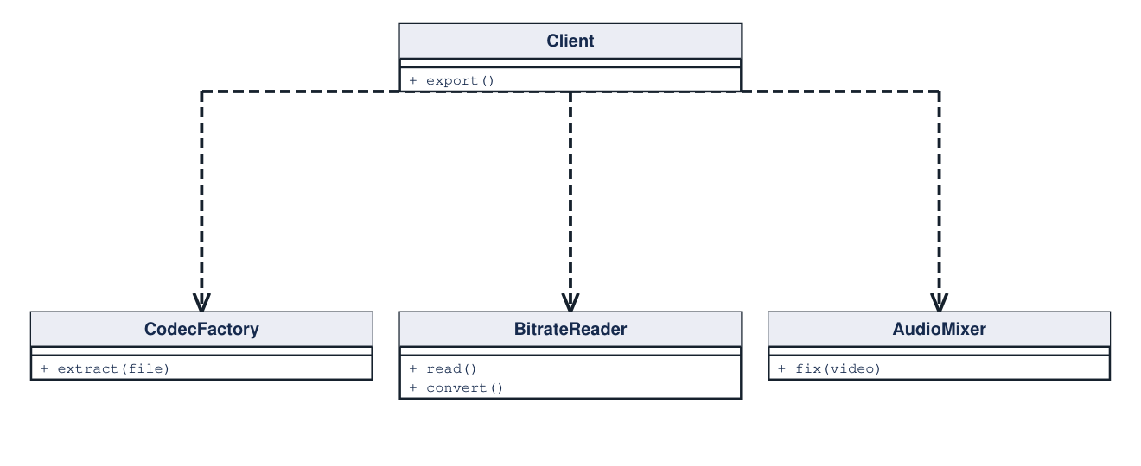
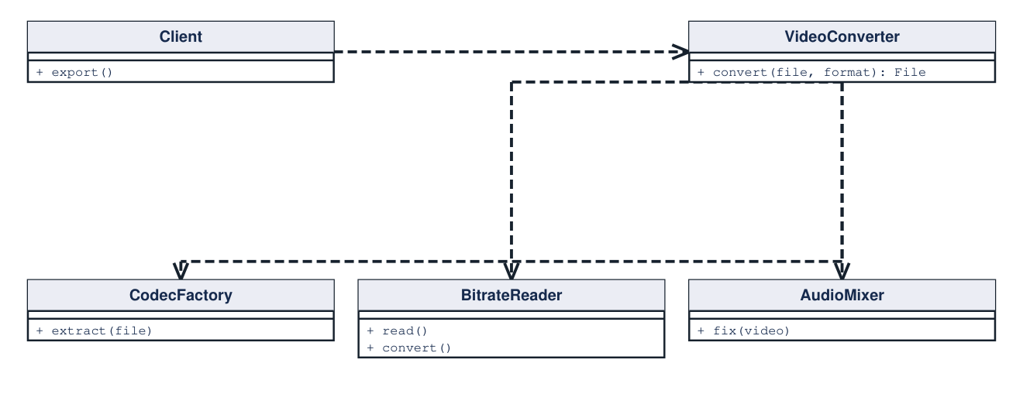
Facade
Structural Design Pattern
Expose a simple entry point to a complex subsystem.
CASE STUDY: Video conversion subsystem
07 / 14
Problem
Solution
Every client coordinates codecs, bitrate conversion, and audio repair.
A facade orchestrates the subsystem behind one conversion call.
Before (direct coupling)
After (using Facade)
Client Code (Before)
Pseudocode
Client Code (After)
Pseudocode
codec = CodecFactory.extract(file)
raw = BitrateReader.read(file, codec)
video = BitrateReader.convert(raw, mp4)
result = AudioMixer.fix(video)
converter = new VideoConverter()
result = converter.convert(file, "mp4")
Key Implementation / Notable Module
Pseudocode
// VideoConverter.convert(file, format)
source = CodecFactory.extract(file)
raw = BitrateReader.read(file, source)
video = BitrateReader.convert(raw, codecFor(format))
return AudioMixer.fix(video)
Source: https://refactoring.guru/design-patterns/facade
UML: hollow triangle = inheritance / realization; dashed open arrow = dependency

Slide 8
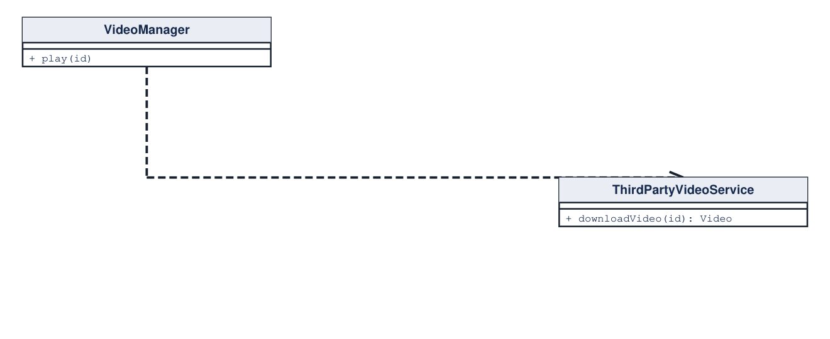
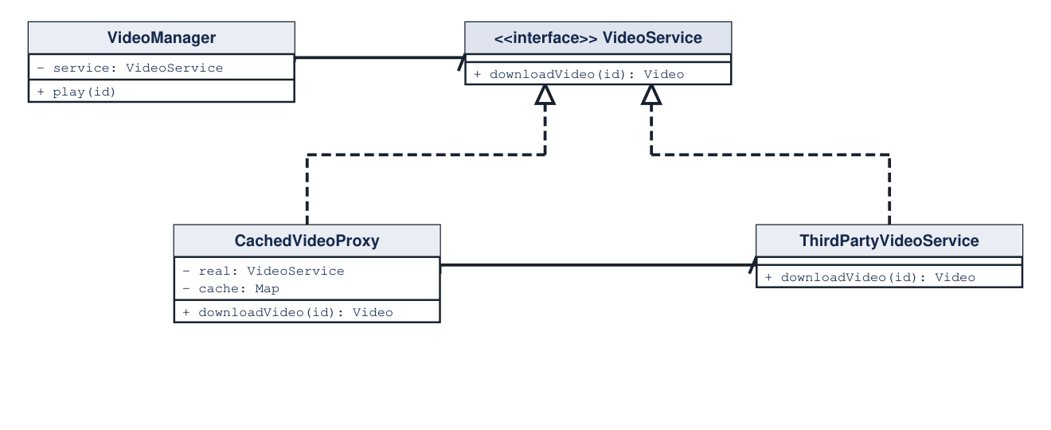
Proxy
Structural Design Pattern
Control access to a service through the same interface.
CASE STUDY: Cached third-party video service
08 / 14
Problem
Solution
Repeated video downloads invoke the remote service again.
A proxy caches results and delegates only on a cache miss.
Before (direct coupling)
After (using Proxy)
Client Code (Before)
Pseudocode
Client Code (After)
Pseudocode
service = new ThirdPartyVideoService()
a = service.downloadVideo(id)
b = service.downloadVideo(id)
// two remote requests
service = new CachedVideoProxy(realService)
a = service.downloadVideo(id)
b = service.downloadVideo(id)
// second request uses the cache
Key Implementation / Notable Module
Pseudocode
// CachedVideoProxy.downloadVideo(id)
if not cache.contains(id):
cache[id] = real.downloadVideo(id)
return cache[id]
Source: https://refactoring.guru/design-patterns/proxy
UML: hollow triangle = inheritance / realization; dashed open arrow = dependency

Slide 9
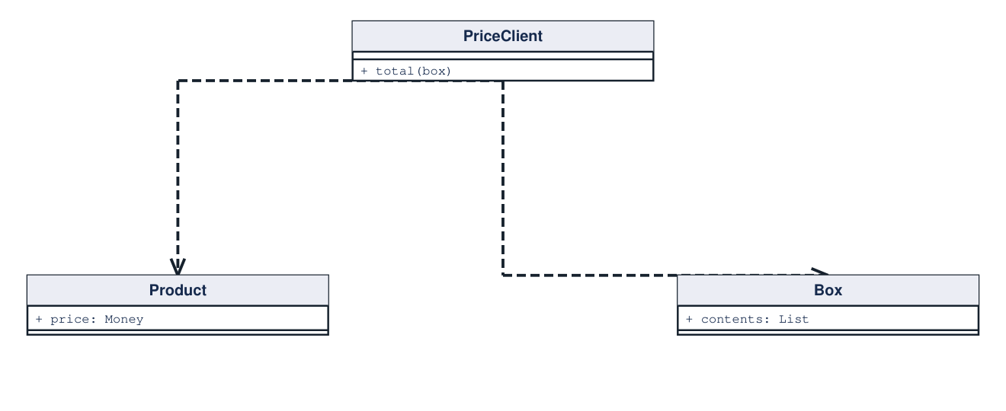
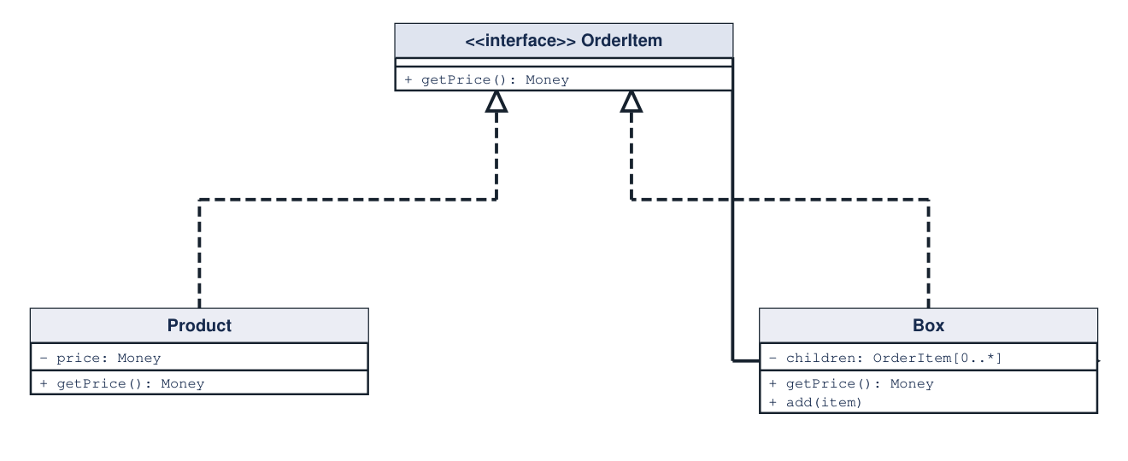
Composite
Structural Design Pattern
Treat individual objects and recursive groups through one interface.
CASE STUDY: Boxes containing products and boxes
09 / 14
Problem
Solution
Pricing code distinguishes products from nested boxes repeatedly.
A box sums child prices; each child follows the same contract.
Before (direct coupling)
After (using Composite)
Client Code (Before)
Pseudocode
Client Code (After)
Pseudocode
total = 0
for item in box.contents:
if item is Product: total += item.price
else: total += priceNestedBox(item)
order = new Box([product, innerBox])
total = order.getPrice()
// leaf and group are both OrderItem
Key Implementation / Notable Module
Pseudocode
// Box.getPrice()
total = 0
for child in children:
total += child.getPrice()
return total
Source: https://refactoring.guru/design-patterns/composite
UML: hollow triangle = inheritance / realization; dashed open arrow = dependency

Slide 10
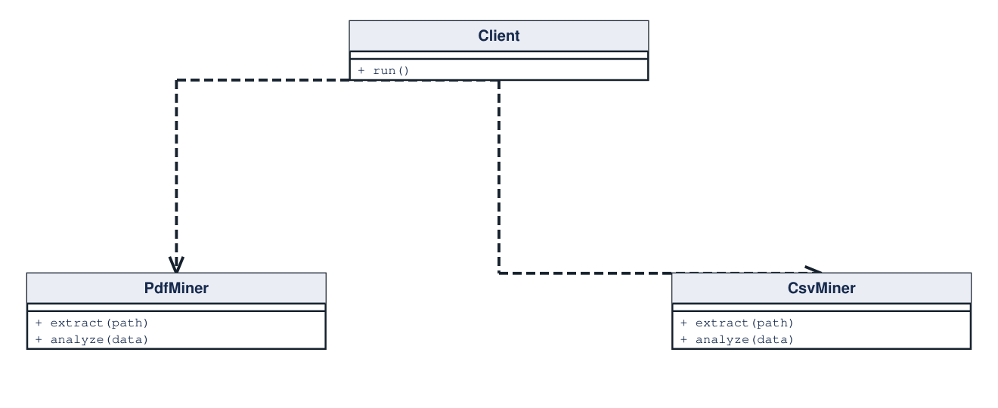
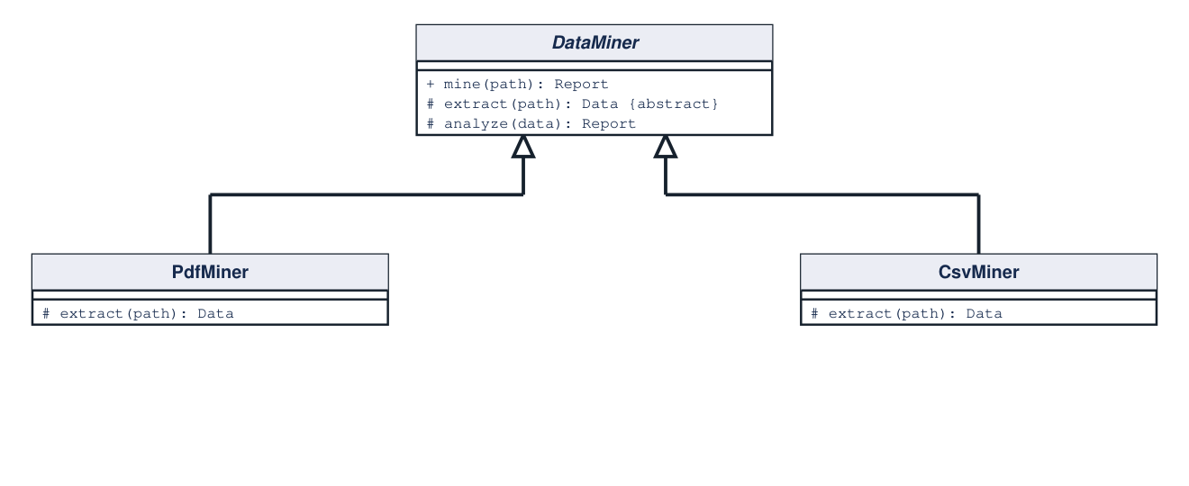
Template Method
Behavioral Design Pattern
Fix an algorithm’s order while subclasses implement selected steps.
CASE STUDY: Mining PDF and CSV documents
10 / 14
Problem
Solution
Format-specific miners duplicate the processing and reporting pipeline.
Move the sequence into a base method; override extraction only.
Before (direct coupling)
After (using Template Method)
Client Code (Before)
Pseudocode
Client Code (After)
Pseudocode
if format == "pdf":
data = pdf.extract(path)
else: data = csv.extract(path)
report = analyze(data)
miner = new PdfMiner()
report = miner.mine(path)
// CsvMiner uses the same pipeline
Key Implementation / Notable Module
Pseudocode
// DataMiner.mine(path): fixed sequence
data = extract(path)
return analyze(data)
// PdfMiner.extract(path): return parsePdf(path)
Source: https://refactoring.guru/design-patterns/template-method
UML: hollow triangle = inheritance / realization; dashed open arrow = dependency

Slide 11
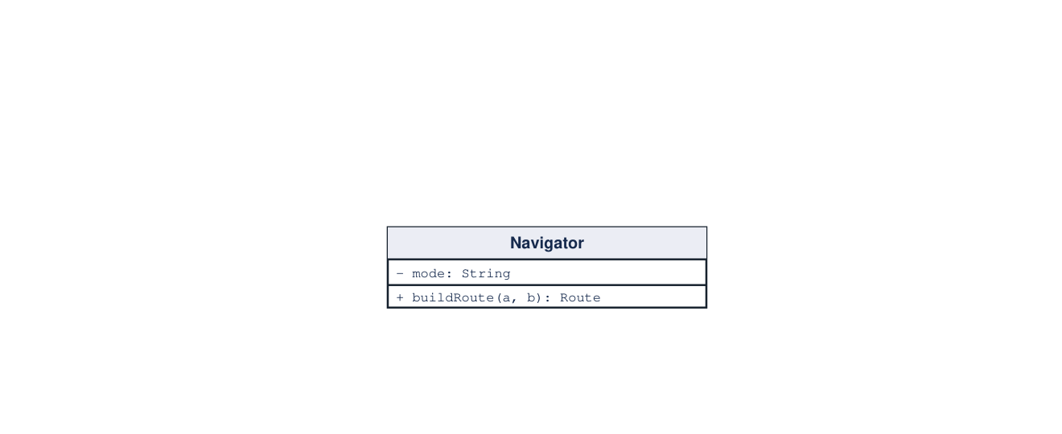
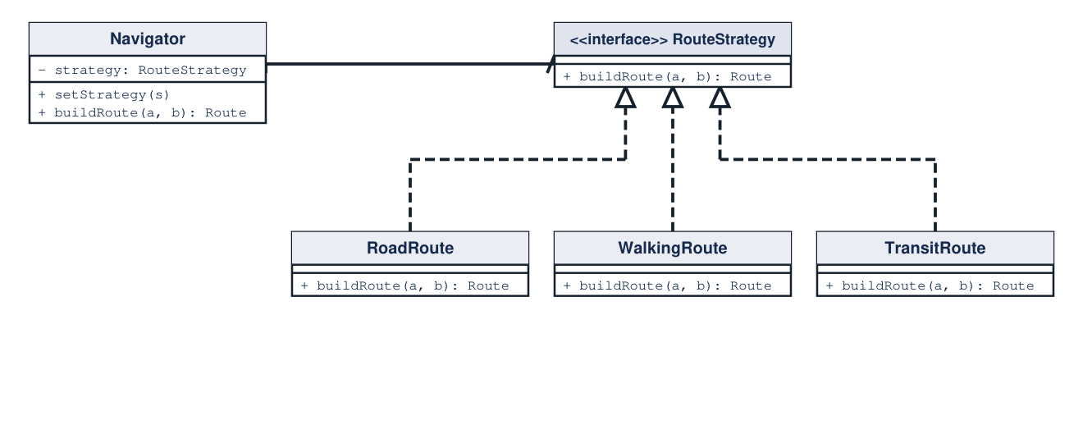
Strategy
Behavioral Design Pattern
Make alternative algorithms interchangeable through a shared contract.
CASE STUDY: Navigation route algorithms
11 / 14
Problem
Solution
A navigator grows conditionals for road, walking, and transit routes.
Delegate routing to a strategy selected by the client.
Before (direct coupling)
After (using Strategy)
Client Code (Before)
Pseudocode
Client Code (After)
Pseudocode
if mode == "road": route = roadRoute(a, b)
elif mode == "walk": route = walkRoute(a, b)
else: route = transitRoute(a, b)
navigator.setStrategy(new WalkingRoute())
route = navigator.buildRoute(a, b)
// choose another strategy at runtime
Key Implementation / Notable Module
Pseudocode
// Navigator.buildRoute(a, b)
return strategy.buildRoute(a, b)
// WalkingRoute builds pedestrian paths
Source: https://refactoring.guru/design-patterns/strategy
UML: hollow triangle = inheritance / realization; dashed open arrow = dependency

Slide 12
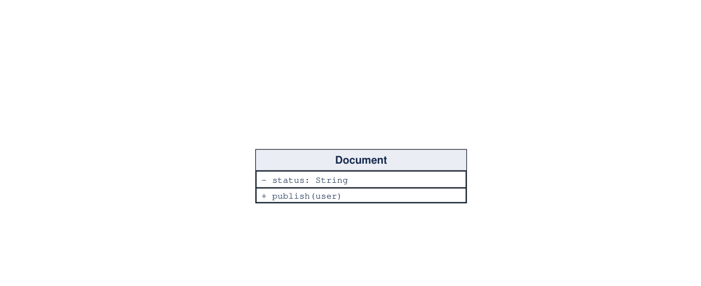
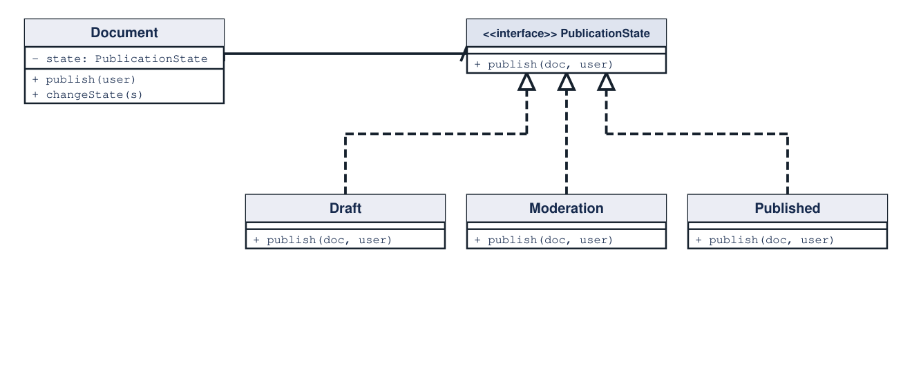
State
Behavioral Design Pattern
Delegate behavior to an object representing the current state.
CASE STUDY: Document publication workflow
12 / 14
Problem
Solution
Publication rules accumulate in a switch over document status.
Each state handles publish and can transition the document.
Before (direct coupling)
After (using State)
Client Code (Before)
Pseudocode
Client Code (After)
Pseudocode
if doc.status == "draft":
doc.status = "moderation"
elif doc.status == "moderation" and user.isAdmin:
doc.status = "published"
doc = new Document(new Draft())
doc.publish(user) // enters moderation
doc.publish(admin) // becomes published
Key Implementation / Notable Module
Pseudocode
// Moderation.publish(doc, user)
if user.isAdmin:
doc.changeState(new Published())
// Published.publish(...) does nothing
Source: https://refactoring.guru/design-patterns/state
UML: hollow triangle = inheritance / realization; dashed open arrow = dependency

Slide 13
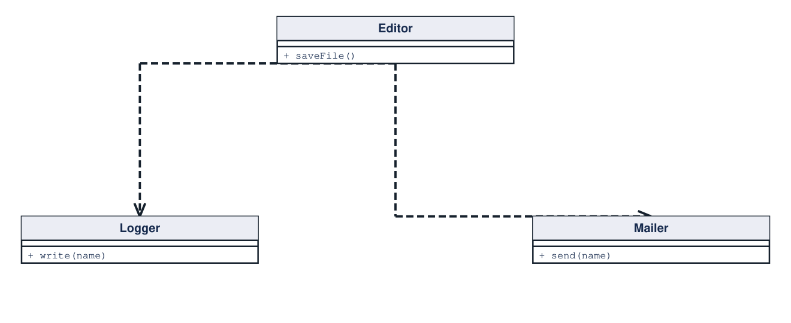
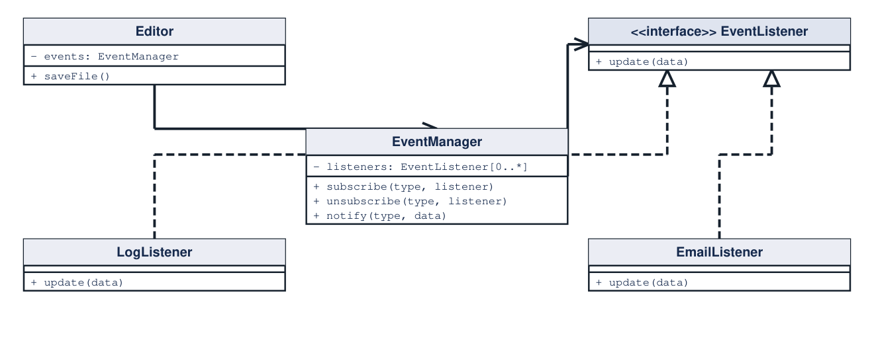
Observer
Behavioral Design Pattern
Notify registered subscribers when a publisher emits an event.
CASE STUDY: Editor events notify logging and email
13 / 14
Problem
Solution
Editor logic directly invokes concrete logging and email services.
Publish an event; subscribers handle their own reactions.
Before (direct coupling)
After (using Observer)
Client Code (Before)
Pseudocode
Client Code (After)
Pseudocode
editor.saveFile()
logger.write(file.name)
mailer.send(file.name)
// client must wire every reaction
events.subscribe("save", new LogListener())
events.subscribe("save", new EmailListener())
editor.saveFile() // emits save event
Key Implementation / Notable Module
Pseudocode
// EventManager.notify(type, data)
for listener in listeners[type]:
listener.update(data)
// Editor.saveFile(): write(); events.notify("save", name)
Source: https://refactoring.guru/design-patterns/observer
UML: hollow triangle = inheritance / realization; dashed open arrow = dependency

Slide 14
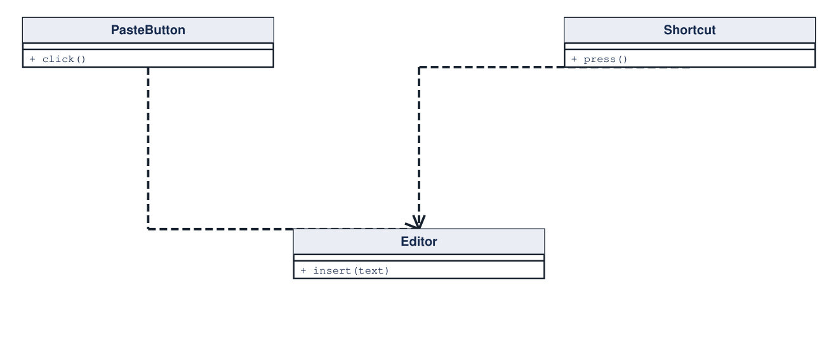
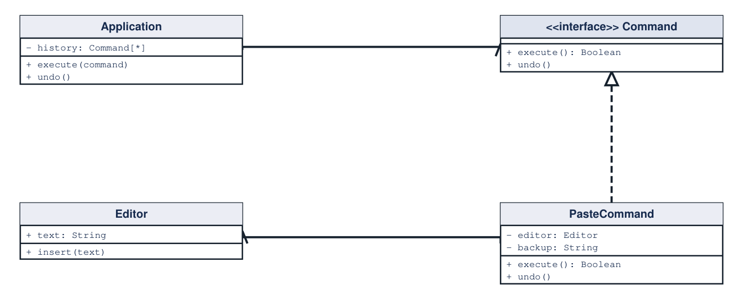
Command
Behavioral Design Pattern
Represent a request as an object that can be invoked and undone.
CASE STUDY: Undoable text-editor actions
14 / 14
Problem
Solution
Buttons and shortcuts duplicate editing actions without shared undo.
Bind both triggers to a command; store successful edits in history.
Before (direct coupling)
After (using Command)
Client Code (Before)
Pseudocode
Client Code (After)
Pseudocode
pasteButton.onClick(() => editor.insert(text))
shortcut.onPress(() => editor.insert(text))
// duplicated action; no undo record
paste = new PasteCommand(editor, text)
pasteButton.bind(() => app.execute(paste))
shortcut.bind(() => app.execute(paste))
app.undo()
Key Implementation / Notable Module
Pseudocode
// PasteCommand.execute()
backup = editor.text; editor.insert(text)
return true // app records command in history
// undo(): editor.text = backup
Source: https://refactoring.guru/design-patterns/command
UML: hollow triangle = inheritance / realization; dashed open arrow = dependency

